Slide 1


Spotify Regression Project

Slide 2
Overview
Dataset and Objective
EDA
Preprocessing
Feature Engineering
Regression Models
Summary and Future Directions

Slide 3
Data and Objective
The dataset chosen for this project has 170,653 rows, each representing one music track on Spotify originally released between 1921 to Nov. 2020.
The 19 columns of the dataset contain various features of the tracks:
Valence (Float ranging 0 to 1)
Year (Release year)
Acousticness (Float ranging 0 to 1)
Artists (List of artists)
Danceability (Float ranging 0 to 1)
Duration_ms (Integer)
Energy (Float ranging 0 to 1)
Explicit (0 /1)
id (Unique string track generated by Spotify)
Instrumentalness (Float ranging 0 to 1)
Key (Key encoding 0 to 11 - C = 0, C# = 1, etc.)
Liveness (Float ranging 0 to 100)
Loudness (Float typically ranging from -60 to 0)
Mode (0: Minor / 1: Major)
Name (Name of the song)
Popularity (Float ranging 0 to 100)
Release_date
Speechiness (Float ranging 0 to 100)
Tempo (Float typically ranging from 50 to 150)
Objective
Attempt to predict the popularity of a contemporary track (song) on Spotify based on the track’s features.
Data is originally from Spotify (available through API) and was taken from Kaggle.
Source: https://www.kaggle.com/yamaerenay/spotify-dataset-19212020-160k-tracks

Slide 4
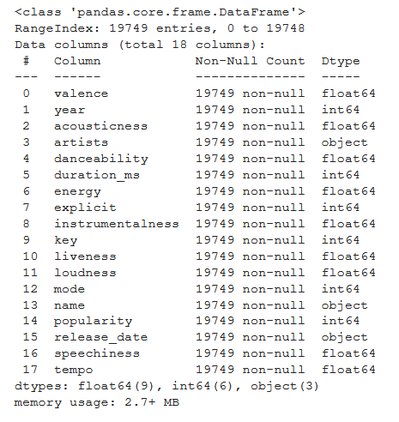
EDA (1/5)
Original data set has 170,653 rows, each representing one track originally released between 1921 to Nov. 2020.
Since we are trying to predict the popularity of a contemporary or new song, tracks released before 2011 were dropped – leaving us with 19,788 tracks released in the last decade.
Initial analysis:
No missing values.
No duplicates found.
However, after dropping the unique “id” feature, 39 duplicate rows were found and removed, resulting in 19,749 rows.
Preliminary transformations:
Converted duration from milliseconds to minutes.
Added textual values of modality (minor, major) for graphs and easier analysis.
Added textual values of keys (C,D,E,etc.) for graphs and easier analysis.
Added textual explanation of explicitness (“Explicit”, “Not explicit or unknown”).

Slide 5
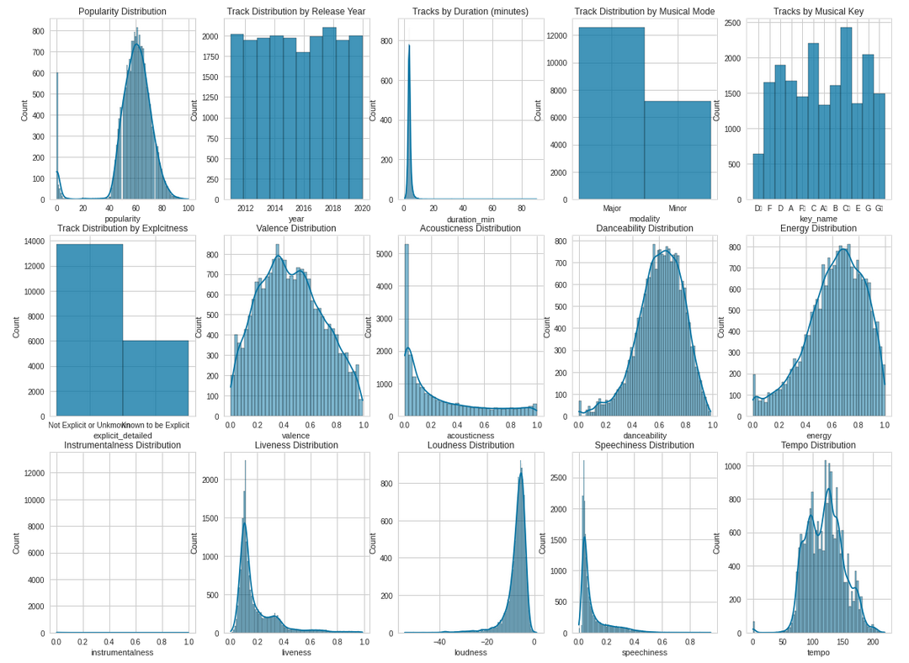
EDA (2/5)
Most numerical features are on a 0-1 scale
Potential outliers:
Duration
Tempo
Rescale to 0 to 1?
Duration
Tempo
Loudness
Popularity
What the f%$#?
Instrumentalness

Slide 6
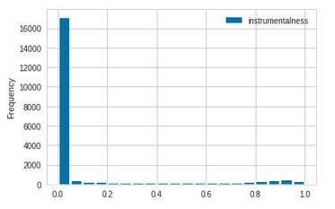
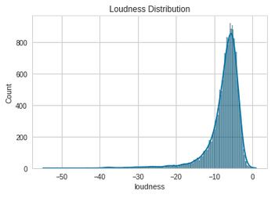
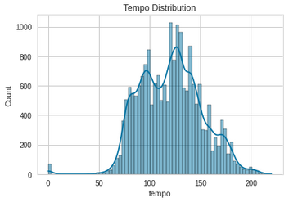
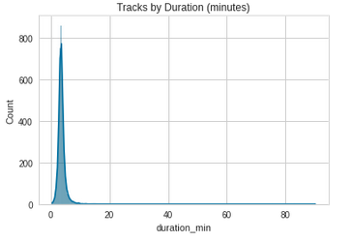
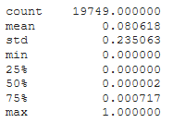
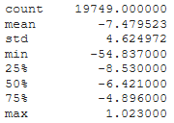
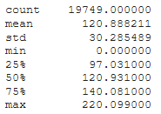
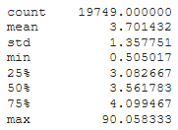
EDA (3/5)
Instrumentalness
Loudness
Tempo
Duration
Decision:
Split to 3 categories:
under 0.2
between 0.2 and 0.8
over 0.8
Decision:
Rescale to 0-1 using MinMax
Decision:
Drop tracks with tempo=0 (68 tracks)
Rescale to 0-1 using MinMax
Decision:
Drop outliers using 3 stdev (265 tracks)
Rescale to 0-1 using MinMax
Popularity
Decision:
Divide by 100 to rescale to 0-1
Result: loss of 333 rows (1.7%)

Slide 7
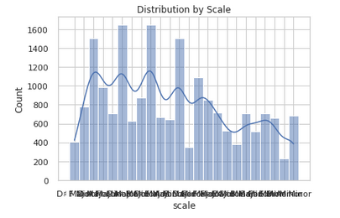
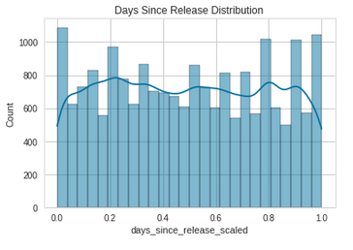
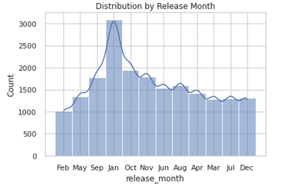
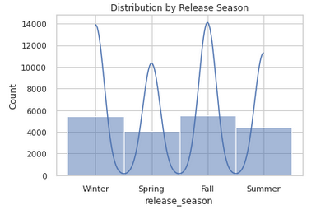
Data Enrichment
Added new feature ”scale” – combination of “key” (C) and “mode” (major) - i.e. C# major, Bb minor, etc.
Added ”days since release” – computed # of days between release date and database date (scaled to 0-1)
Added ”release month” – extracted from “release date” - i.e. Jan, Feb, Mar, etc.
Added new feature ”release season” – combination of months - i.e. Dec, Jan, Feb -> “Winter”, etc.

Slide 8
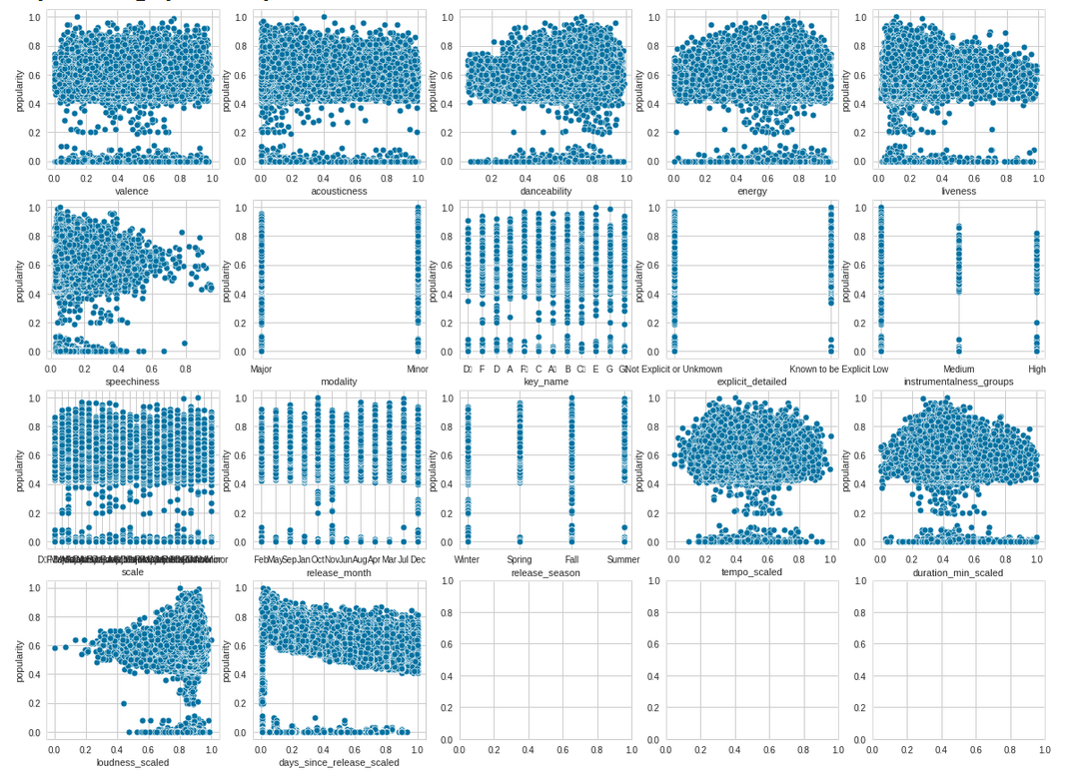
Feature Selection
With plotting it is difficult to see correlations with popularity

Slide 9
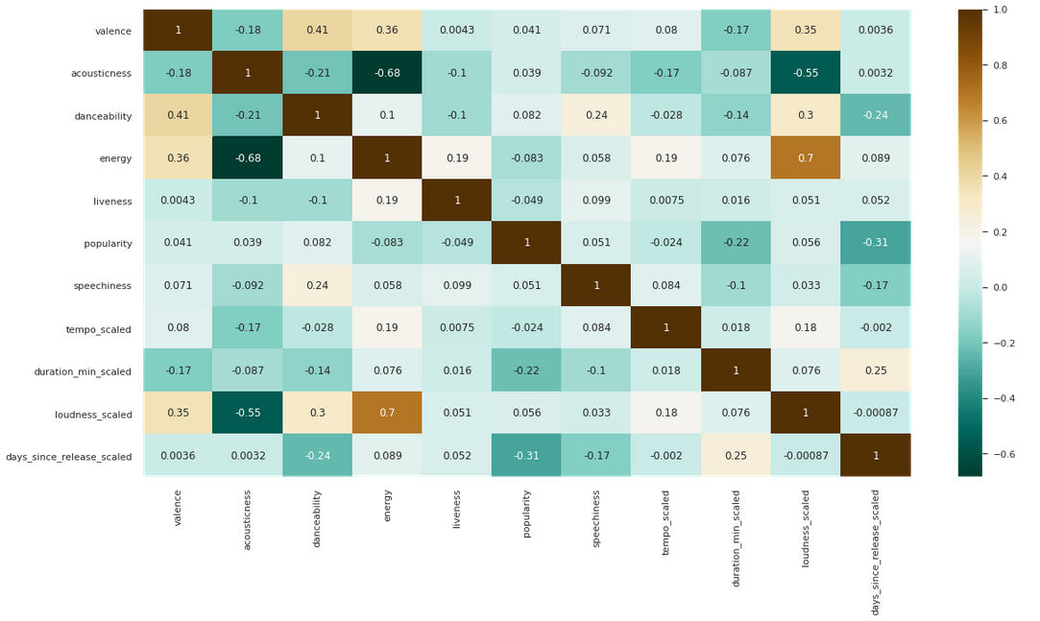
Correlation Matrix
High correlations between features:
Energy & loudness
Valence & danceability
Valence & energy
Valence & loudness
Energy & acousticness (neg)
Loudness & acousticness (neg)
High correlations with popularity:
Duration
Days since release (neg)
Matrix only shows numerical features

Slide 10
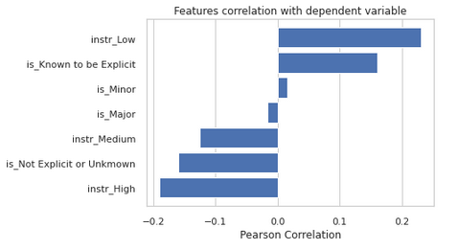
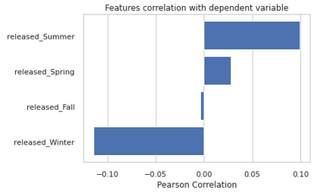
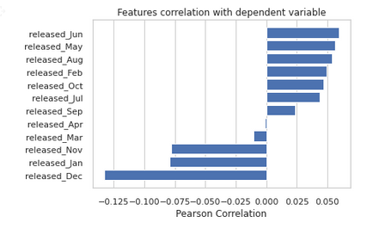
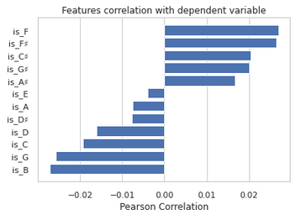
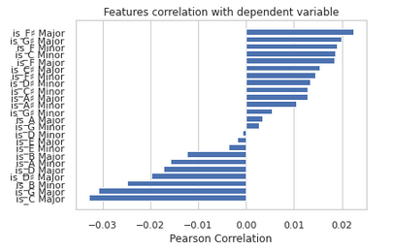
Categorical Feature Correlation
Used one hot encoding (added 58 dummy variables) to examine correlation of categorical features with popularity using Pearson correlation visualizer. Dummies were then dropped and not used for regression.

Slide 11
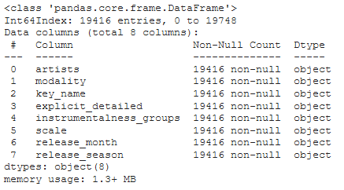

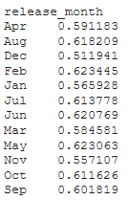

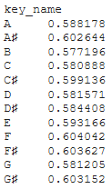

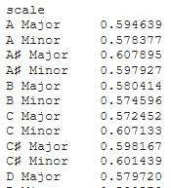

Pre-processing (1/2)
Applied target encoding to transform 8 categorical features using means from the training set data.
Season means (popularity) will replace season categories.
Month means (popularity) will replace month categories.
Modality means (popularity) will replace mode categories.
Explicitness means (popularity) will explicitness categories.
Key means (popularity) will replace key categories.
Modality means (popularity) will replace mode categories.
Scale means (popularity) will replace scale categories.
Instrumental groups (popularity) will replace instrumentalness.

Slide 12
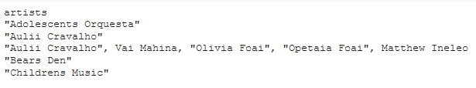

Pre-processing (2/2)
Artists *
Initially thought to drop this along with the name of the song.
Artist means (popularity) will replace artist name when there are 3 or more rows from the same artist in the training set.
Otherwise, will replace the artist's name with the overall popularity mean of the training set.
In the testing set, an unknown artist will be replaced with the overall popularity mean of the training set .
* This solution has 2 unsolved problems :
Does not handle multiple artists on the same track (i.e. song by Bruno Mars and Beyonce). A combination is treated as a separate artist.
Does not take time into account (the popularity of a track from a specific artist should only be influenced by the popularity of the artist’s previous tracks).

Slide 13

Linear Regression
Metric | Train | Test
Mean Absolute Error )MAE) | 0.076439 | 0.077052
Mean Squared Error (MSE) | 0.013383 | 0.013103
Root Mean Square Error (RMSE) | 0.115688 | 0.114470
R2 | 0.384753 | 0.341499
For popularity (unscaled) multiply RMSE X 100 (i.e. 11.5688 out of 100)

Slide 14
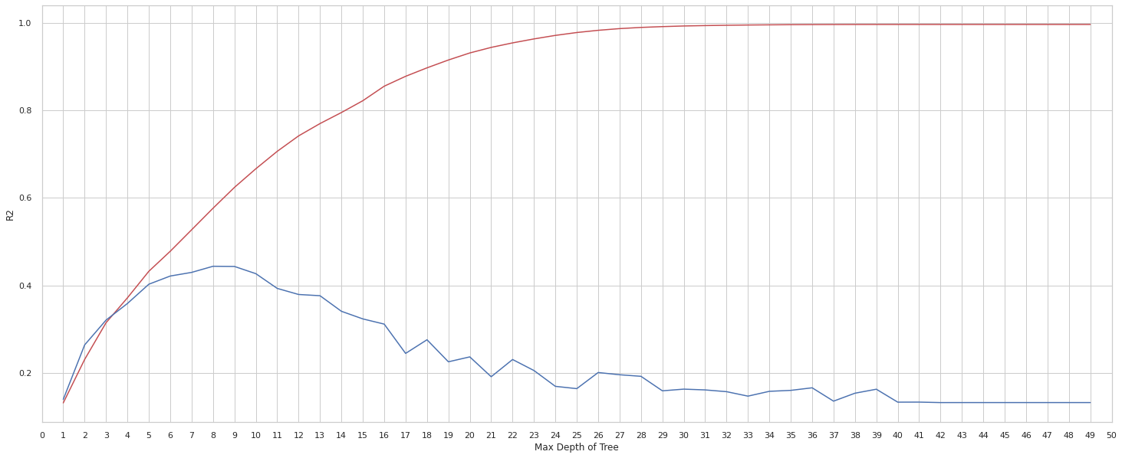
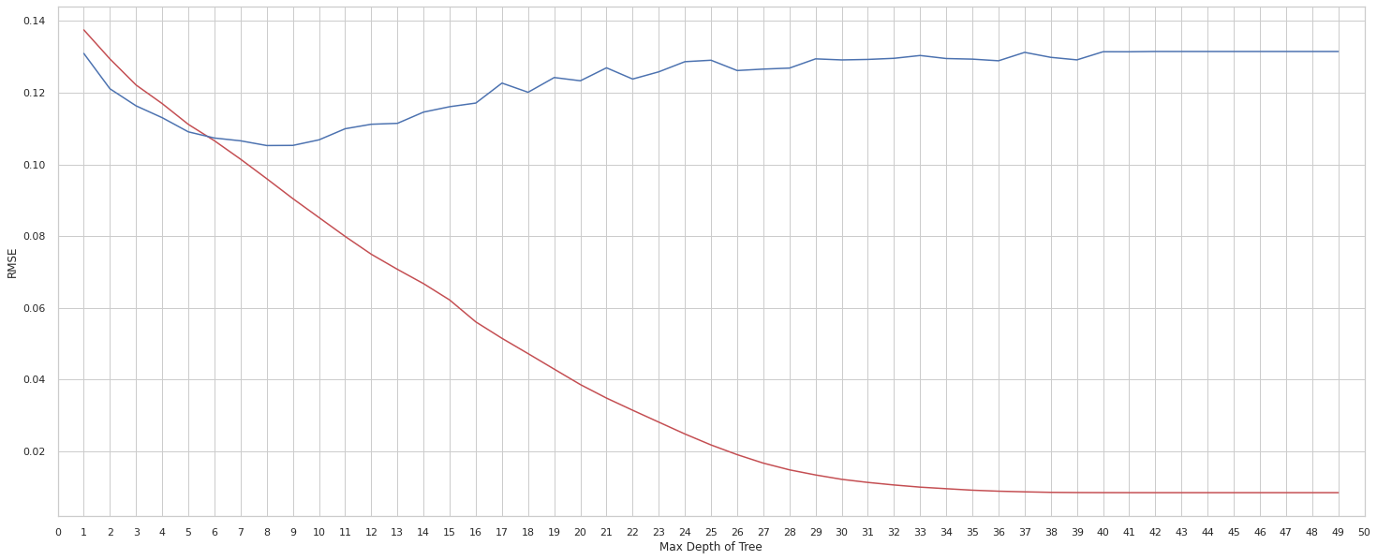
Regression Tree
R² vs. Max Depth of Tree
Train
Results for Regression Tree (max depth = 8)
Metric | Train | Test
Root Mean Square Error (RMSE) | 0.096005 | 0.104603
R2 | 0.576377 | 0.450477
Test
RMSE vs. Max Depth of Tree
Test
# of Leaves = 140
Train

Slide 15

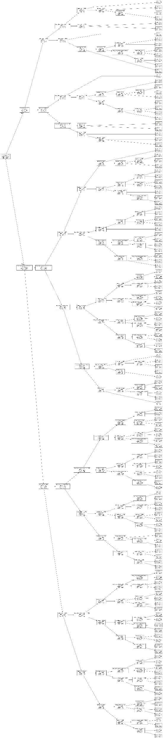




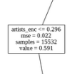






Regression Tree
Top Nodes
Full Tree
Results for Regression Tree (max depth = 8)
Metric | Train | Test
Root Mean Square Error (RMSE) | 0.096005 | 0.104603
R2 | 0.576377 | 0.450477
# of Leaves = 140

Slide 16
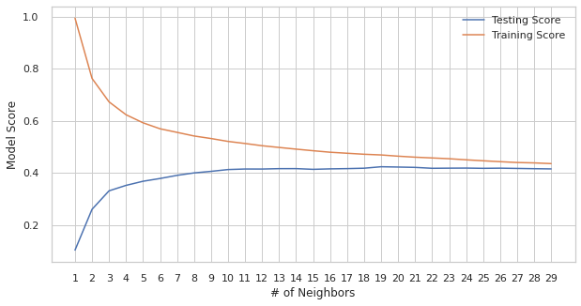
K Nearest Neighbors
K (# of nearest neighbors) | Root Mean Square Error (RMSE) |  | Accuracy Score
Metric | Train | Test | Train | Train (CV=5) | Test
5 (default) | 0.094228 | 0.112206 | 0.591915 | 0.376604 | 0.367696
11 (GridSearch) | 0.103885 | 0.107961 | 0.512561 | 0.402489 | 0.414629
19 (Loop) | 0.107525 | 0.107156 | 0.468614 | 0.396945 | 0.423332

Slide 17
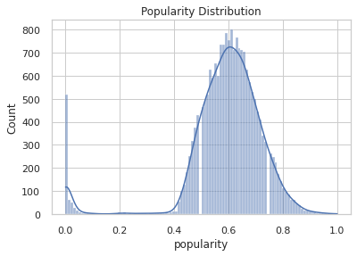
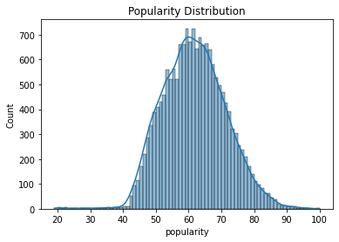
Removing Outliers from Target
Remove outliers (3 stdev) from target?
?
Not sure we can allow a track to have a popularity of zero:
Could be an error
Track could be new
Track may not have enough clicks for a score
Other reasons

Slide 18
Linear Regression
With Popularity Outliers
Without Popularity Outliers
Metric | Train | Test
Root Mean Square Error (RMSE) | 0.115688 | 0.114470
R2 | 0.384753 | 0.341499
Metric | Train | Test
Root Mean Square Error (RMSE) | 0.071141 | 0.073387
R2 | 0.433742 | 0.381877
Regression Tree
With Popularity Outliers
Without Popularity Outliers
Metric | Train | Test
Root Mean Square Error (RMSE) | 0.096005 | 0.104603
R2 | 0.576377 | 0.450477
Metric | Train | Test
Root Mean Square Error (RMSE) | 0.062652 | 0.073387
R2 | 0.560811 | 0.401364
Depth=8
Depth=4

Slide 19
Thoughts and Future Directions
Does the musical genre influence popularity? Are heavy metal songs more popular than hip-hop songs? (Spoiler: NO! )
Different musical genres may have different regressions on the various features (i.e. “speechiness” will have a greater correlation to popularity of songs from the genres “rap” and “hip-hop”).
Many features are highly correlated (loudness and energy, etc.) – is it better practice to reduce the number of features (using factor analysis).
“Popularity” in Spotify is a score from 0 to 100 – but what makes a track a “hit”? Is there a popularity score threshold (i.e. score over 75?). This can be a classification exercise.
Will be interesting to predict song success on an external contest (not Spotify) – for example predict a song’s popularity on the “Billboard Hot 100” based on the Spotify song features.

Slide 20
Thank You

